Slide 1

Driving Growth Through Sam
Adams Variety Packs

Slide 2
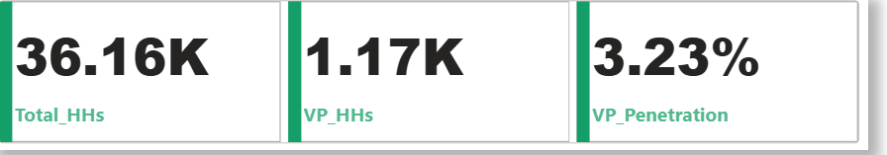
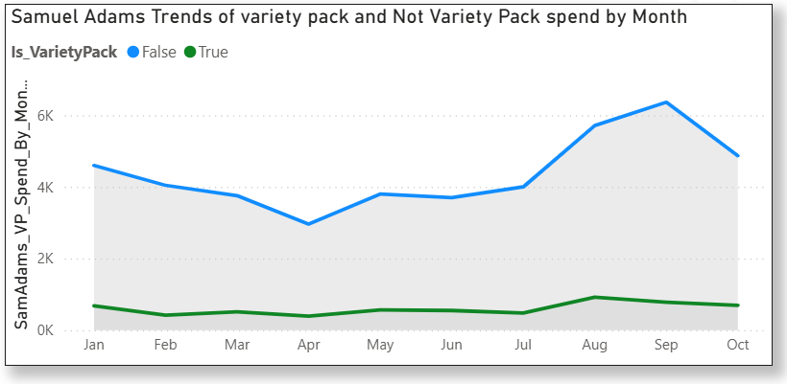
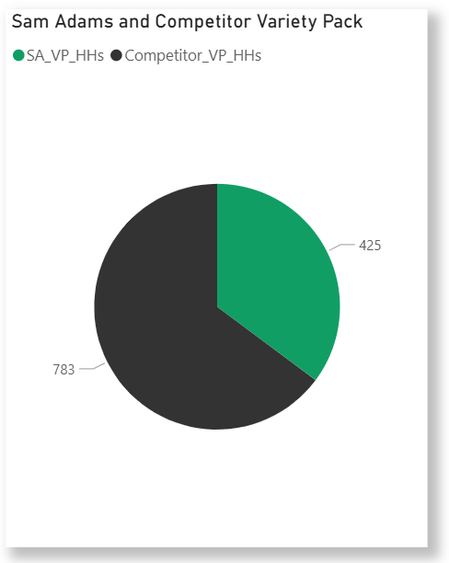
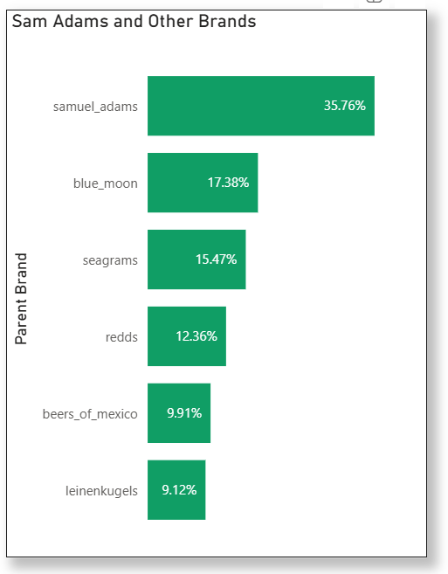
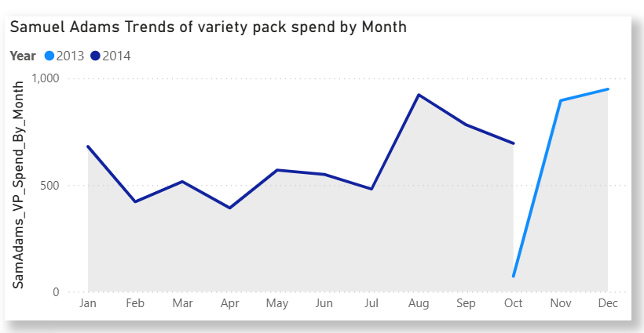
Market Performance & Trial Behavior (Sam Adams vs Competitors)
Sam Adams Variety Packs to Competitor Variety Pack
The Percentage of Adams Variety Packs is 35.76 %
The Total Percentage of the Competitive Variety Pack is 64.24%
This shows that Variety Pack is a true trial vehicle geared towards additional of the brand.
Yes, the production should be expanded.

Slide 3
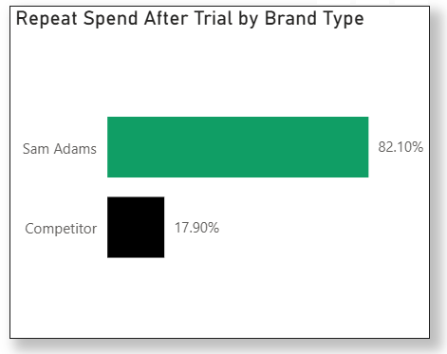
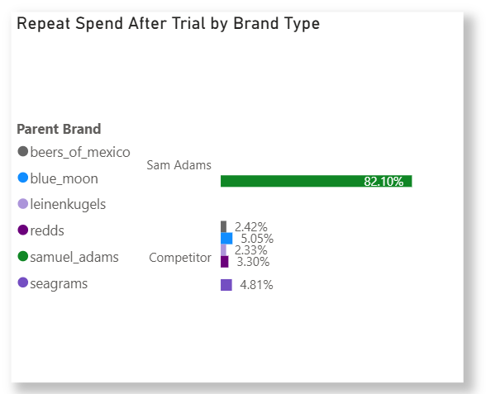
Repeat Spend Advantage & Seasonal Performance
Trend of Samuel Adams Variety Pack and Non-Variety Packs
The trend of Variety Pack and Non-Variety Pack shows relationships
As Variety Pack increases, Non-Variety Pack Increases
As Variety Pack decreases, Non-Variety Pack decreases
This shows that Variety Pack is a true trial vehicle geared towards additional of the brand.
Seasonal Sales Pattern
Feb - Jul (Low Demand )
July - Aug (Peak Demand)
Sep - Oct ( Low Demand)
Nov- Dec ( Demand Increase)
During the drop- down season Sam Adam should market the brand in store To:
Drive trial and awareness
Influence purchase decisions at the point of sales
In-store visibility makes seasonal packs more attractive.
Showcase sharing potential

Slide 4
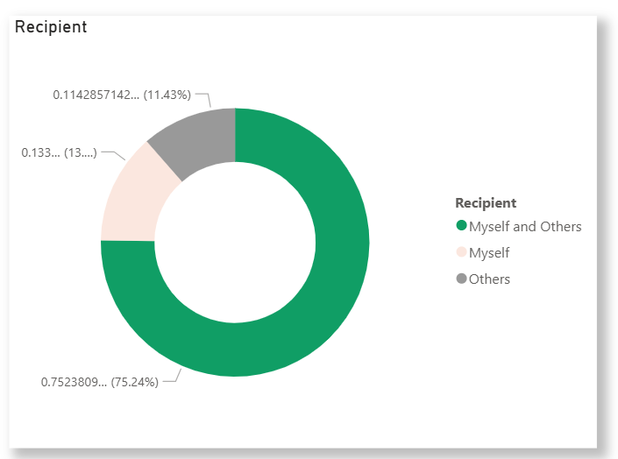
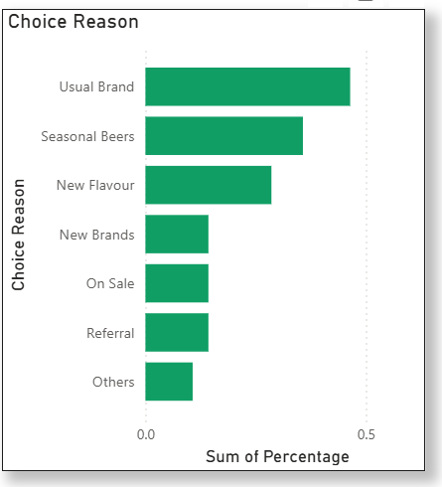
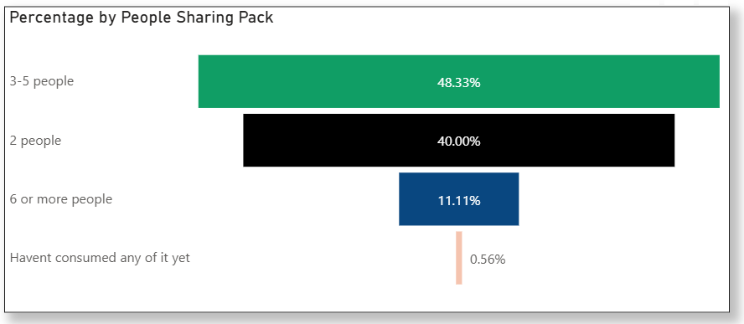
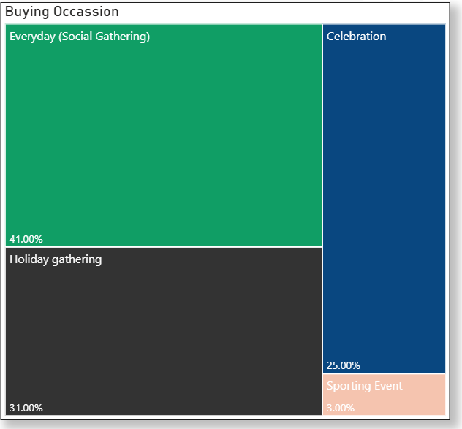
Variety Pack Consumer Insights
Recipient of Purchase
People mainly buy variety packs for others hosting, gifting, sharing
Choice Reason
Choice behavior shows familiarity and seasonal variety drive purchase more than discounts or referrals
Pack Sharing
Variety packs are group-oriented products. Consumers rarely drink them alone.
Buying Occasion
Everyday social gatherings are the top driver.
Variety packs are not only for big events, they are an everyday social choice
How to Merchandise In-Store
Place packs in high-traffic zones
Use “Made for Sharing” group-focused displays.
Highlight Seasonal Variety Packs with special signage.
Position near party essentials to cue hosting occasions.
Ensure cold availability for immediate group consumption.
When to Market Them In-Store
Peak push: May–August
Steady support: January–July.
Seasonal spikes: Promote each Seasonal Variety Pack at launch.
What Should the Marketing Message Be?
Sharing: “Perfect for Hosting. A Flavor for Everyone.”
Everyday social: “Your Everyday Social Pack.”
Seasonal: “Limited Seasonal Flavors, Try Them Now.”
Trial: “Explore Multiple Flavors in One Pack.”
Next Steps & Future Research
Expand distribution in social-driven channels.
A/B Test to identify the best performing variant of variety packs
Analyse why the higher gathering has lower percentage

